Slide 1
The
Composable Architecture
How TCA helps in building the Scalable iOS Applications

Slide 2

About Me
Kanagasabapathy TR
Lead iOS Developer at TechM
Crafting iOS App for more than a decade
A clean code freak
Blogs on iOS development at Medium

Slide 3
Table of Contents
Introduction
TCA vs Others
What's Unidirectional flow
Deep dive into TCA architecture
Building Blocks (State, Action and Reducer)
DEMO
What’s Next and Take away

Slide 4
TCA - Overview
The Composable Architecture (TCA) developed by two friends Brendan William and Stephen Cellis
This Architecture is a based of ELM and Redux
Which Offers:
Opinionated Library - Building apps
Multi-Store Architecture
Unidirectional Flow
Handle Side effects

Slide 5

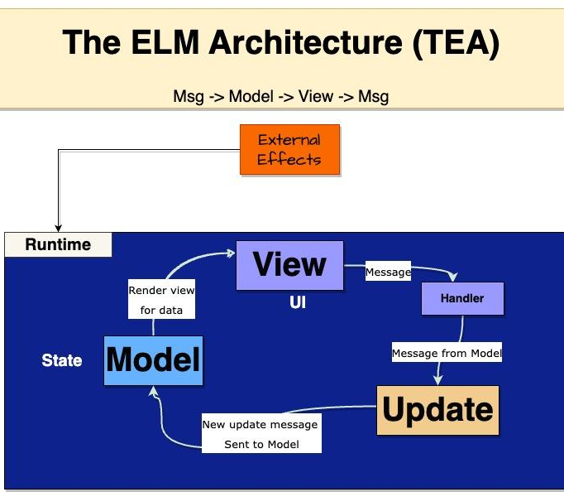
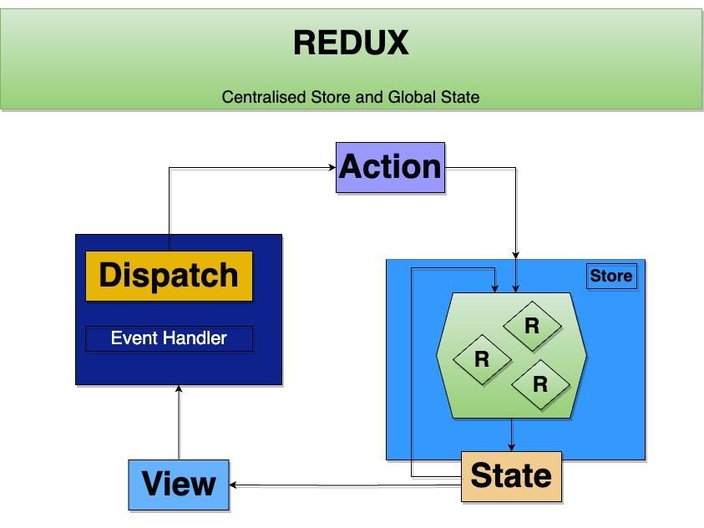

ELM and Redux

Slide 6
Framework Integration
Supported for Swift Package Manager
Released their first version on May 4, 2020
Latest Version - 1.2.0
Open source and supported widely by the community
To install the SDK through Swift Package Manager:
In Xcode, select File > Add Package and enter https://github.com/pointfreeco/swift-composable-architecture as the repository URL

Slide 7
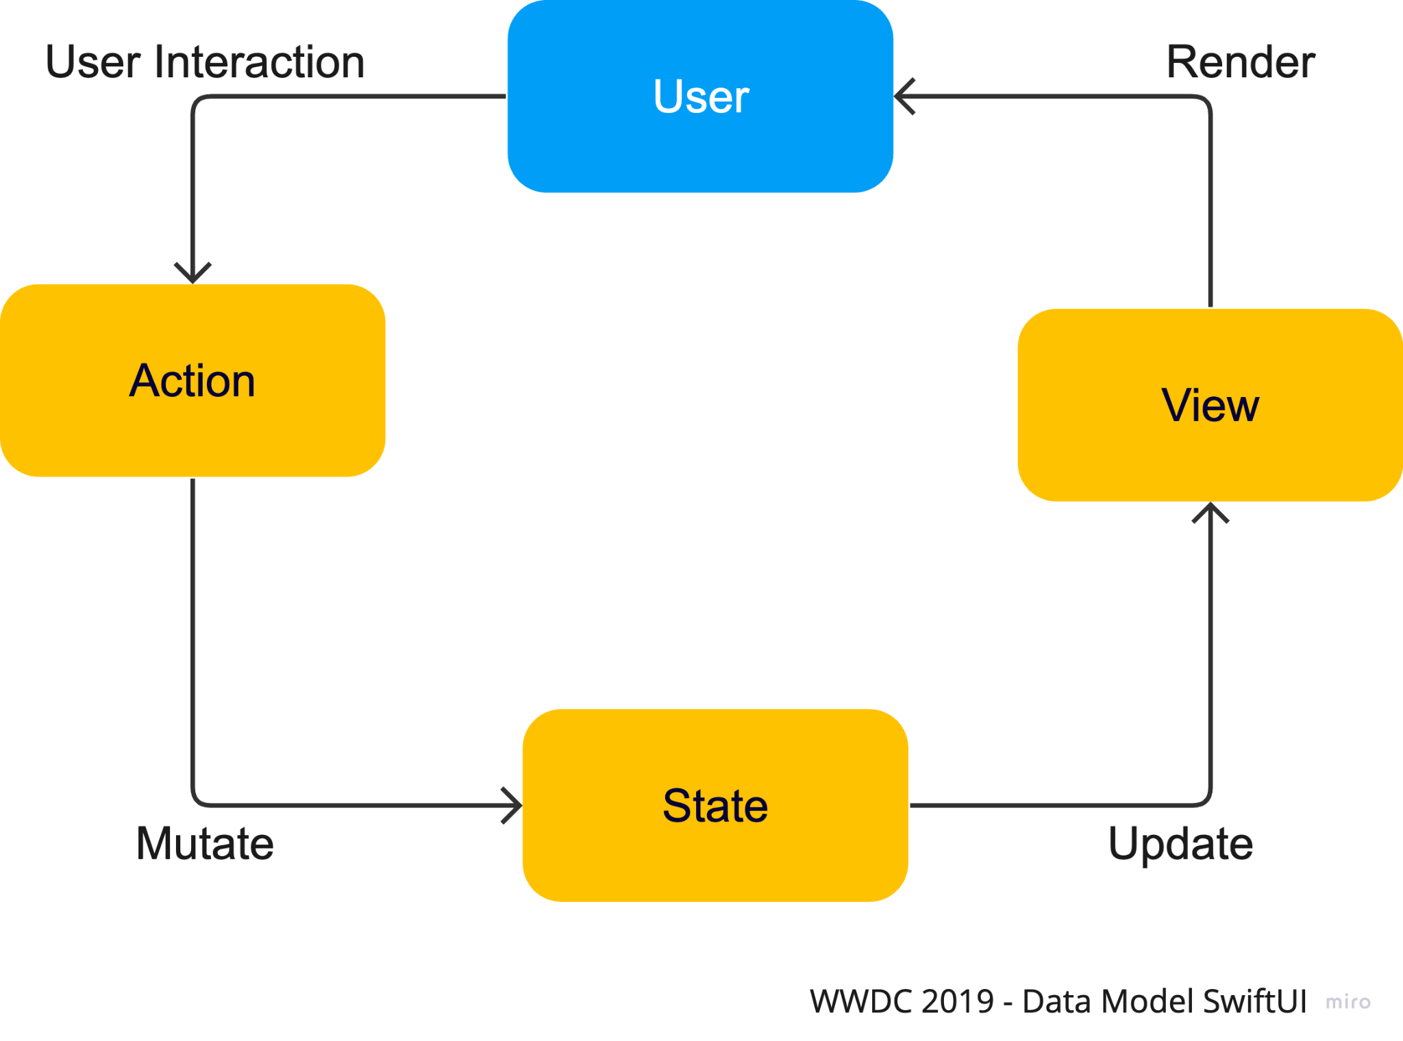
SwiftUI - Declarative UI
SwiftUI uses Declarative Syntax
UI = func(State)
In UIKit,
App State is inconsistent with View State
Losing Synchronization
In SwiftUI,
Synchronization
App state is consistent

Slide 8
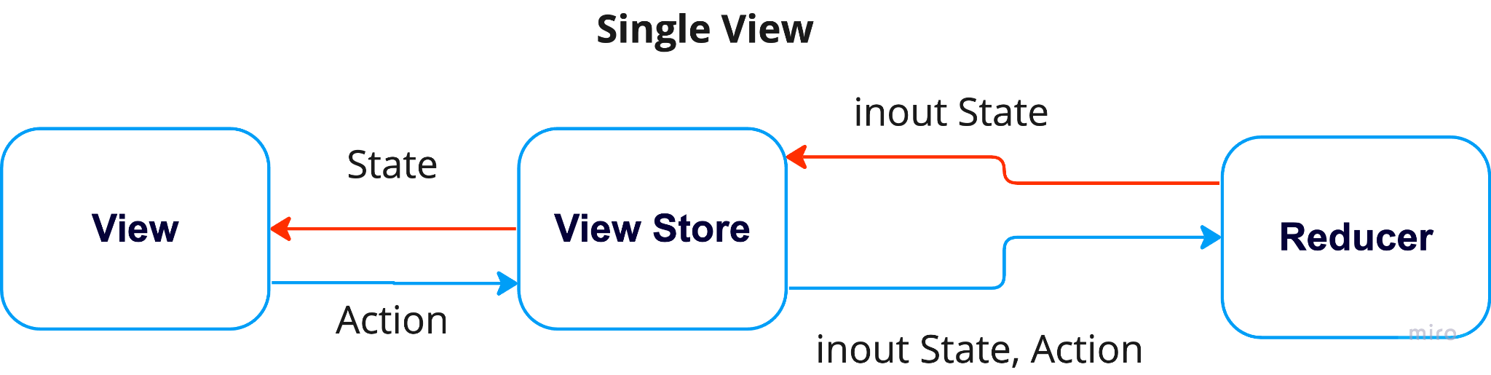
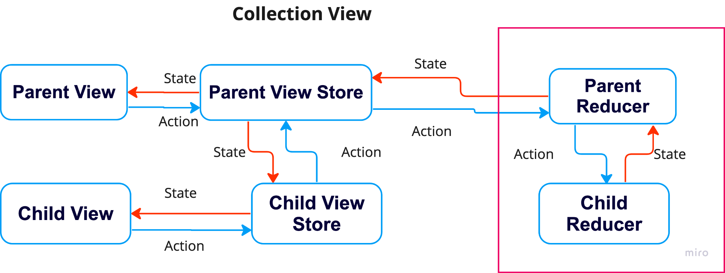
What's Unidirectional flow?

Slide 9
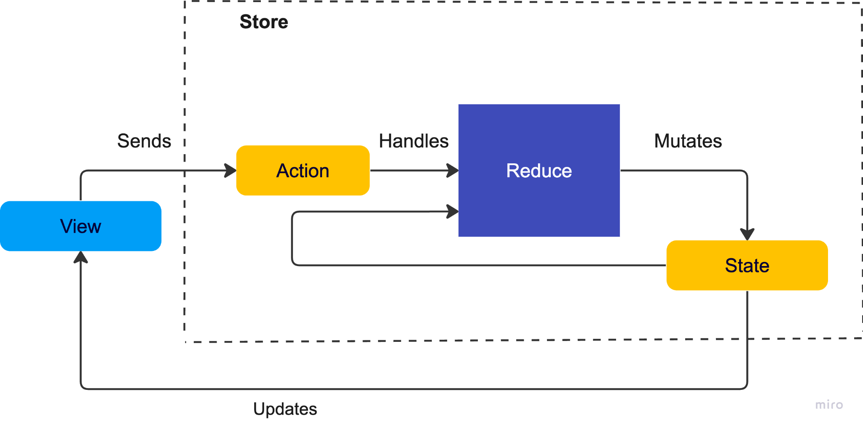
Deep dive into TCA architecture

Slide 10
Building blocks
There are 3 major building blocks of the architecture, they are:
State
Action
Reducer
And other sub blocks like
Store
Effect
Environment

Slide 11
State
A type that describes the data your feature needs to perform its logic and render its UI.
Needed for logic and UI
Collection of properties
Single way to mutate state - Dispatching Actions to a Store which holds the State
struct State: Equatable { var userName }

Slide 12
Action
A type that represents all of the actions that can happen in your feature, such as user actions, notifications, event sources and more.
Enum of all possible Actions
User Actions
Action Response
Timer Fires
enum Action: Equatable { case addUser case removeUser }

Slide 13
Reducer
func reduce(into state: inout State, action: Action) -> Effect<Action> { switch action { case .onAppear: return .none } }
(OR)
public var body: some Reducer<State, Action> { Reduce { state, action in switch action { case .onAppear: return .none } } }s
A function that describes how to evolve the current state of the app to the next state given an action.
Also responsible for returning any effects that should be run, such as API requests, which can be done by returning an Effect value.

Slide 14
Store
The runtime that actually drives your feature. You send all user actions to the store so that the store can run the reducer and effects, and you can observe state changes in the store so that you can update UI.
Operators
Scope
Combine
Scope - to break stores into smaller ones
Combine - Combine two or more Reducers into a single reducer
final class Store<State, Action>

Slide 15
Scope
@inlinable public init<ChildState, ChildAction>( state toChildState: WritableKeyPath<ParentState, ChildState>, action toChildAction: CasePath<ParentAction, ChildAction>, @ReducerBuilder<ChildState, ChildAction> child: () -> Child ) where ChildState == Child.State, ChildAction == Child.Action { self.init( toChildState: .keyPath(toChildState), toChildAction: toChildAction, child: child() ) }
WritableKeyPath -
Data Accessors for State
backslash
\.someMember
getter and setter
CasePath -
Data Accessors for Actions
forward slash
/.someCase
embed and extract

Slide 16
Effect
A type that encapsulates a unit of work that can be run in the outside world, and can feed data back to the Store.
An event that modifies the state outside of its local context
Reducer returns some value to the Effect
##Declaration:
struct Effect<Action>
##Implementation:
func reduce(into state: inout State, action: Action) -> Effect<Action> { }

Slide 17
Environment
A type that holds all dependencies needed to produce Effects, such as API clients, analytics clients, random number generators.
Known as Dependencies
Network API or database access
@Dependency(\.continuousClock) var clock

Slide 18
TCA vs MVVM vs VIPER
Era of Declarative UI (SwiftUI) - Composable architecture is required
Easy to make UI components and combine/compose the components
Benefits of Declarative UI can be maximized.
Multi Platform - Supports SwiftUI on iOS, WatchOS, MacOS
Modularity in working with teams and reusing the modules
Pure Function Reducer - low boilerplate compared to VIPER
Consistency and Testable compared to MVVM + Coordinator
Protected against the unexpected side-effects and handling

Slide 19
Just jump into a quick Demo

Slide 20
Benefits
Isolation - Isolated local stores and states
Composition - Composition of mini-Modules
Pure Functions - Uses pure functions(Reducer Functions) to update the State
Managing side effects - Functions are executed by the runtime system and produce new actions

Slide 21


Slide 22


